Slide 1

Prediction of CO₂ Emissions by country using IBM Watson
Team Members:
Navya Tatiparthi 18BEI0002 Hariprasath Naresh 19BCE1436 Shiva Prasaath SB 18BEC0652 S.Selva Priya 18BML0034

Slide 2
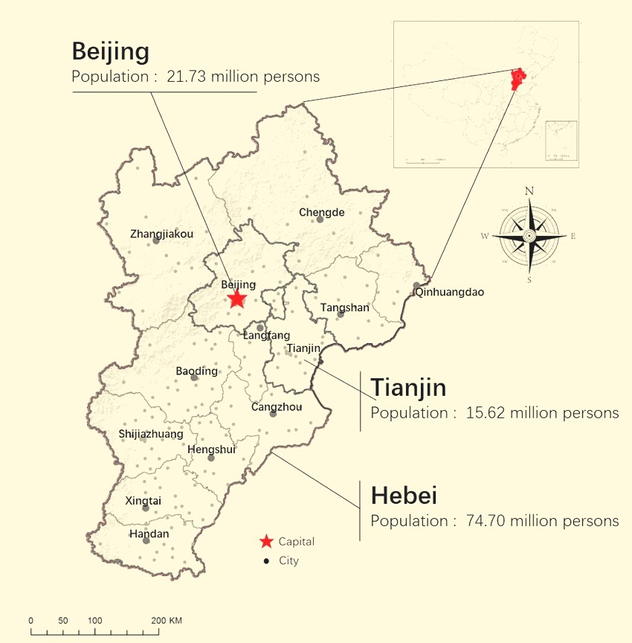
INTRODUCTION
Carbon emissions and environmental protection issues have brought pressure from the International community during Chinese Economic Development
Recently, the Chinese Govt. announced that carbon emissions per unit of GDP would fall by 60-65% compared with 2005 and non-fossil fuel energy would account for 20% of primary energy consumption by 2030.
Hence, forecasting energy consumption is significant to emissions reduction and upgrading energy supply in the Beijing-Tianjin-Hebei region. This study thoroughly analyzes carbon emissions' main energy sources, including coal, petrol, natural gas, and coal power in this region.

Slide 3
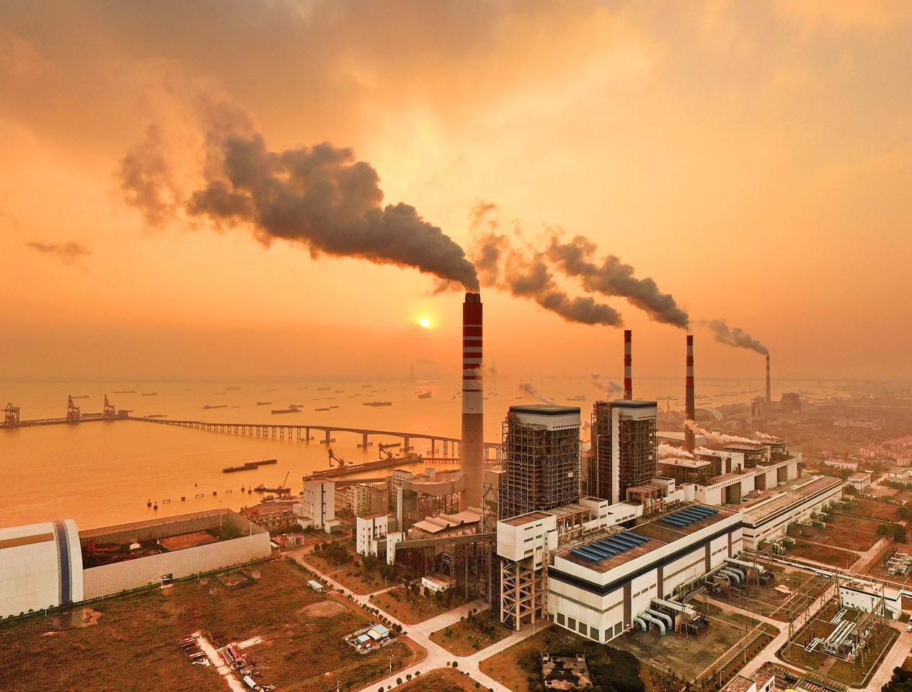
CAUSES OF CO₂ EMISSIONS
Due to human activities, the atmospheric concentration of CO₂ has been rising extensively since the Industrial Revolution and has now reached dangerous levels not seen in the last 3 million years.
Natural sinks remove around the same quantity of CO₂ from the atmosphere that are produced by natural sources. This had kept CO₂ levels balanced and in a safe range.
Human sources of CO₂ emissions are much smaller than natural emissions but they have upset the natural balance that existed for many years before the influence of humans by adding extra CO₂ to the atmosphere without removing any.

Slide 4

PROBLEM STATEMENT
"A Machine Learning model for calculating CO₂ Emissions by country"
Due to the increasingly deteriorating environment, it is time for the government to upgrade the Energy Consumption structure by making use of Machine Learning prediction to analyze and control the CO₂ emissions in future

Slide 5
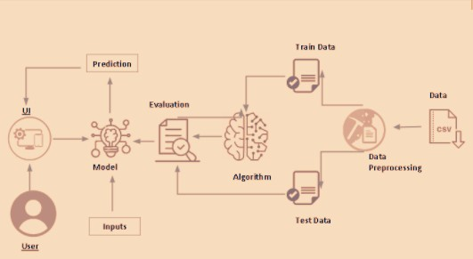
PROJECT ARCHITECTURE & FLOW
Dataset Collection
Data Pre-Processing Model Building
Building Flask Application
Final UI

Slide 6
PROJECT UI

Slide 7
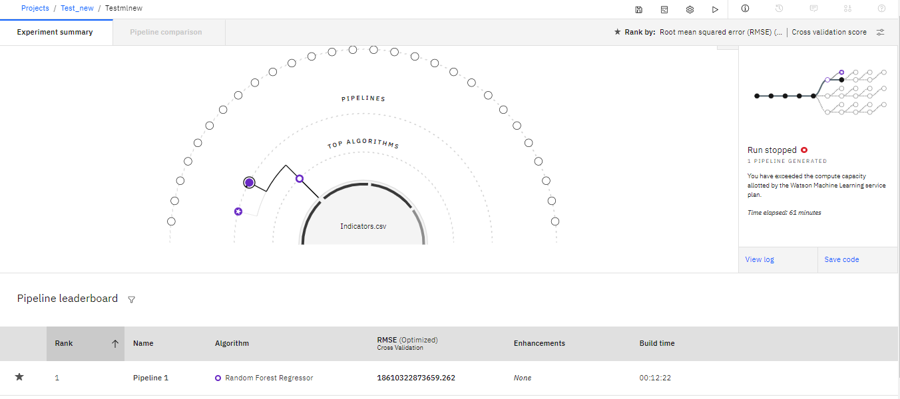
IBM WATSON DEPLOYMENT

Slide 8
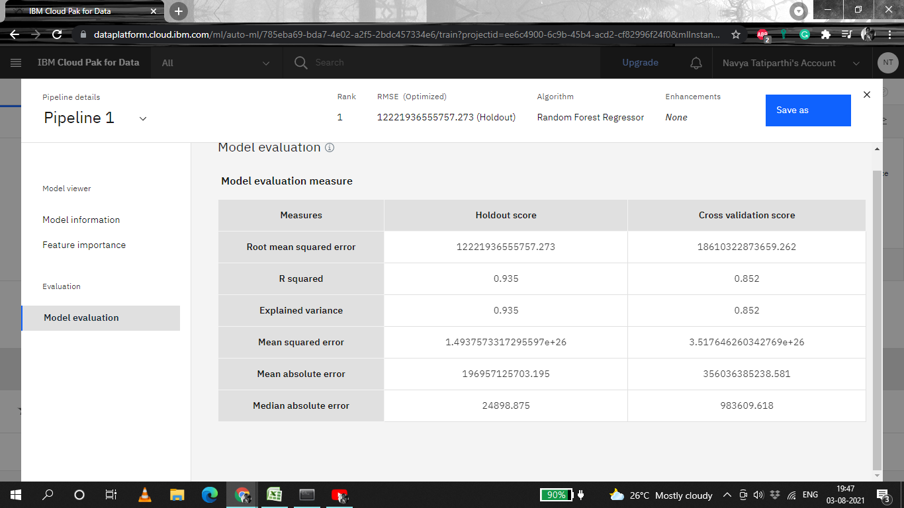
IBM WATSON PREDICTION

